Slide 1
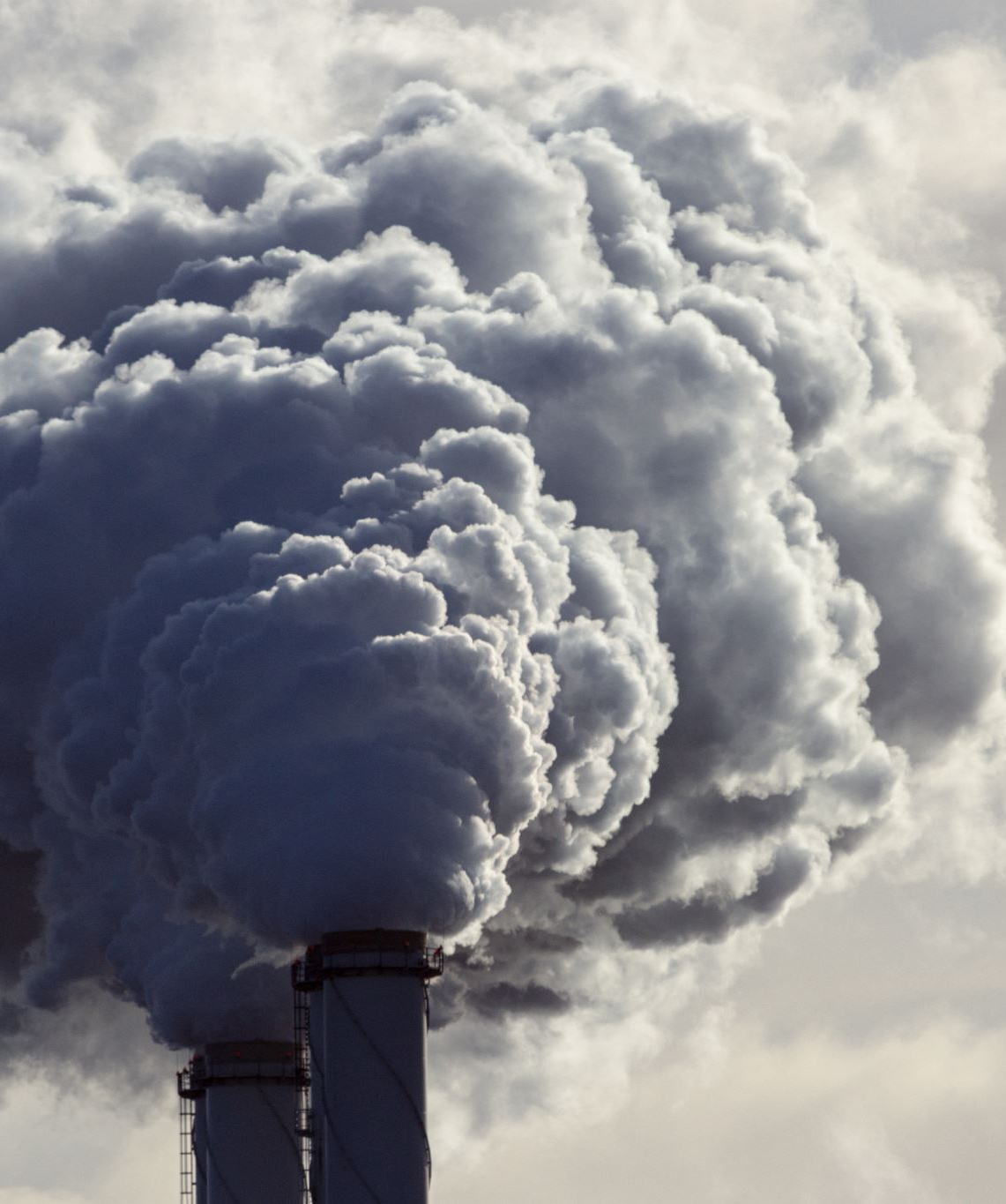
Predicting Air Quality and Pollution Levels Using Machine Learning.
Presented by:
Vishal Balaji Kotrike (EE36010)
Akshay Reddy Gone (AM60898)

Slide 2
PROBLEM EXPLANATION
Air pollution has significant impact on public health and environment
According to World Health Organization (WHO), air pollution causes 7 million deaths each year.
Pollutants like nitrogen oxides (NOx), sulfur dioxide (SO2), and particulate matter (PM2.5, PM10) disrupt the balance in ecosystem.
Air pollution is also responsible for climate change, where Nitrogen dioxide (NO2) is responsible for the formation of ground level ozone (O3).

Slide 3
ADVANTAGES
- Help authorities in large cities forecast air quality and make decisions that reduce pollution.
- Could be applied to design smart city infrastructure that minimizes traffic-related pollution.
- Useful for businesses to optimize operations and comply with environmental regulations.
- Local governments, businesses, and citizens make informed decisions about outdoor activities, transportation, and industrial production

Slide 4

RESEARCH QUESTION
Primary Question:
Can we accurately predict daily AQI levels across different counties using past AQI values and various meteorological and pollutant-related features?
Supporting Question:
How do temporal features (e.g., lagged AQI values and rolling averages) impact the prediction accuracy?

Slide 5
APPROACHING AND ADDRESSING THE PROBLEM
Data Collection
Data Pre-processing
Data Analysis and Visualization
Model Development
Results Interpretation

Slide 6
DATA COLLECTION
Data is obtained from U.S. Environmental Protection Agency (EPA).
Link : https://aqs.epa.gov/aqsweb/airdata/download_files.html
Used Beautiful soup for downloading the datasets.
Data Format: The data is provided in CSV format, with large data sizes from years 2016-2024.
Total Size of the datasets : There are 15 datasets containing 23 columns and 1.6 million rows in each dataset.

Slide 7
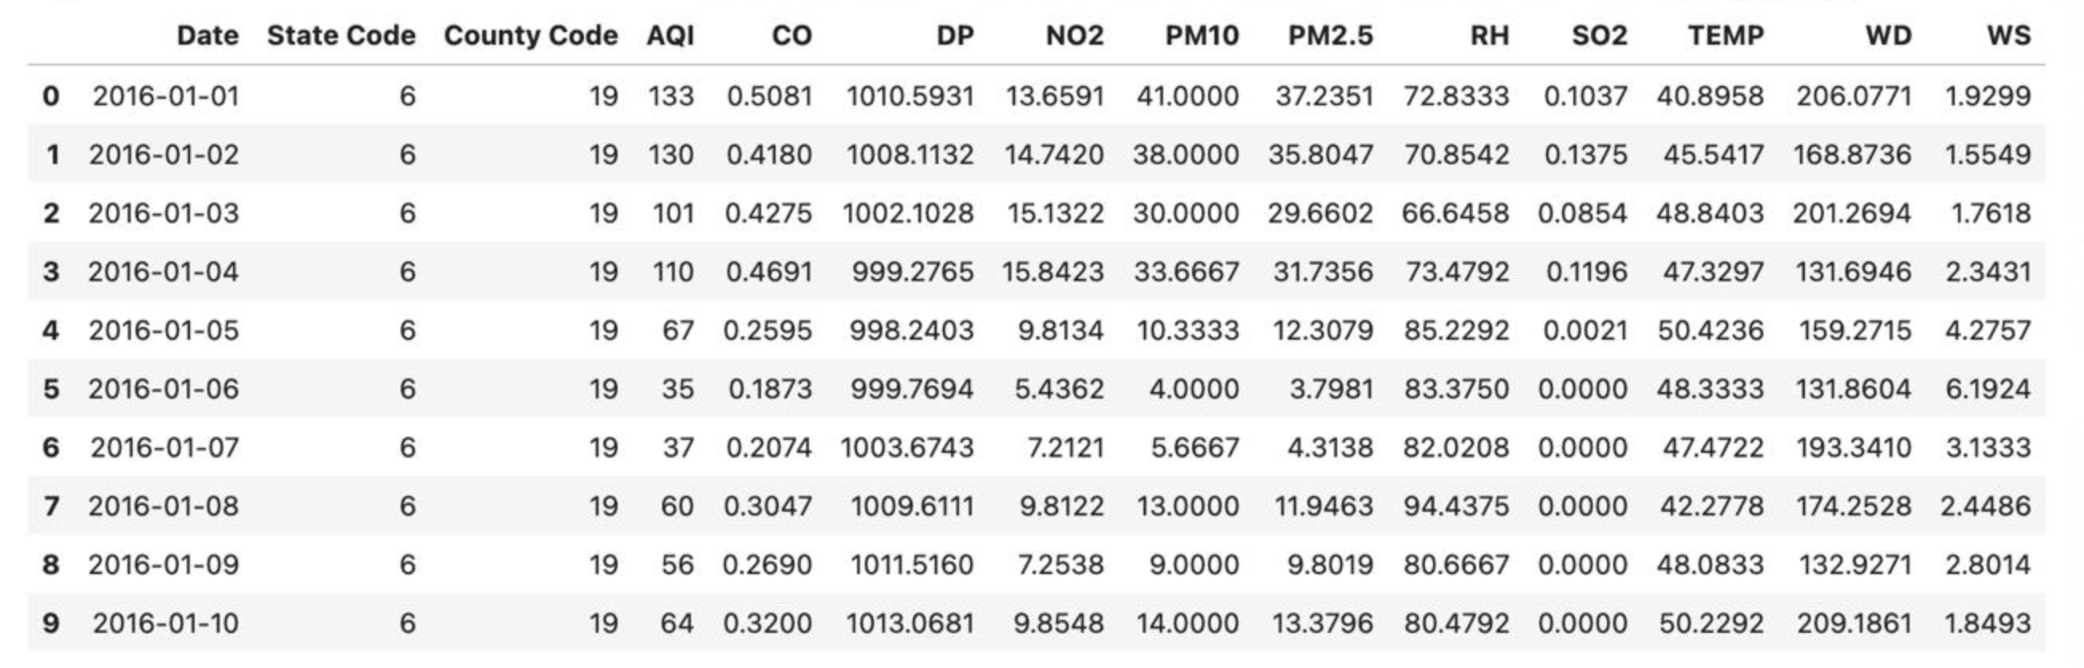
Snapshot Of Dataset

Slide 8
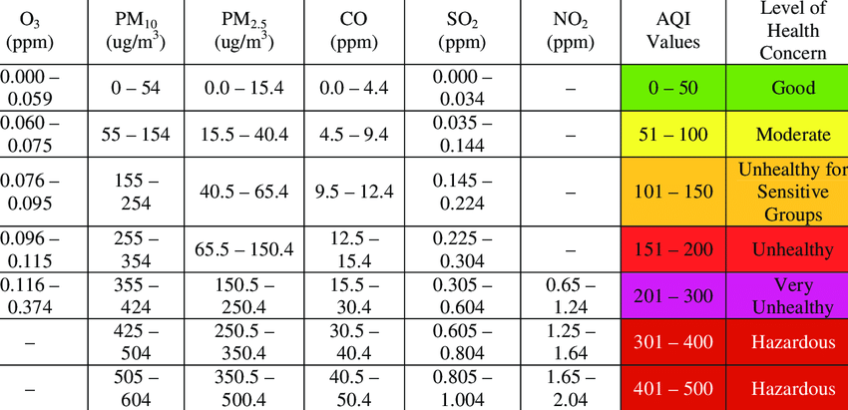
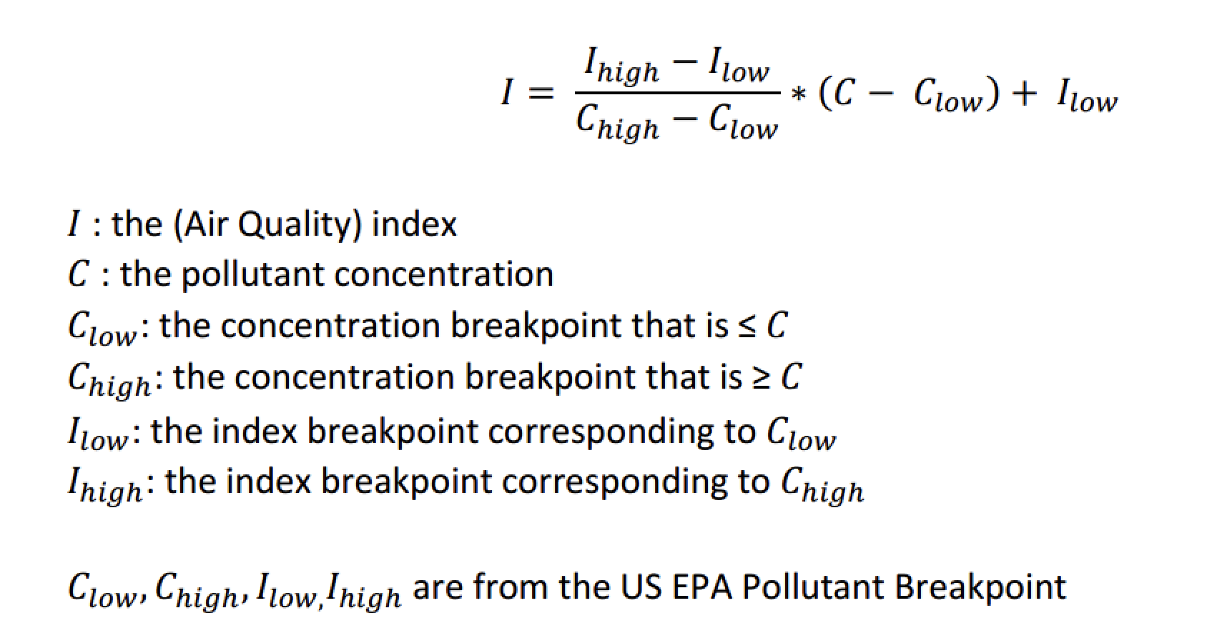
What is AQI?
Air Quality Index : A numerical scale that reports the level of air pollution for a given area and the potential health effects it may cause. For United States, AQI ranges from 0-500.

Slide 9
OVERVIEW OF VARIABLES
TARGET VARIABLE: AQI
DEPENDENT VARIABLES:
POLLUTANT CONCENTRATIONS
PM10 (µg/m³)
PM2.5 (µg/m³)
Nitrogen Dioxide (ppb)
Sulphur Dioxide (ppb)
Carbon Monoxide (ppm)
METEOROLOGICAL VARIABLES
Temperature (C or F)
Humidity (%)
Wind Direction
Windspeed (m/s)
Pressure (mb)

Slide 10
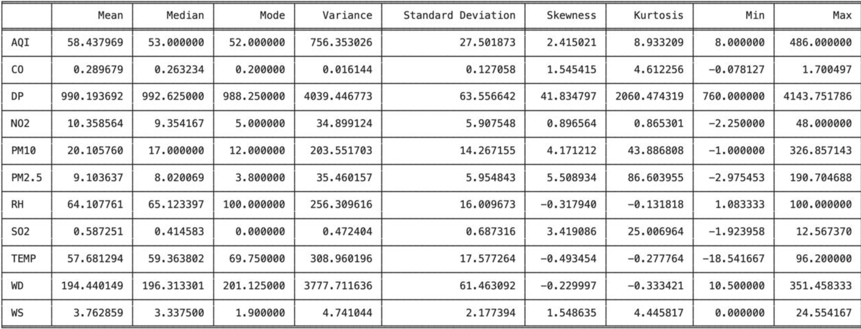
Descriptive Statistics before Data Cleaning

Slide 11
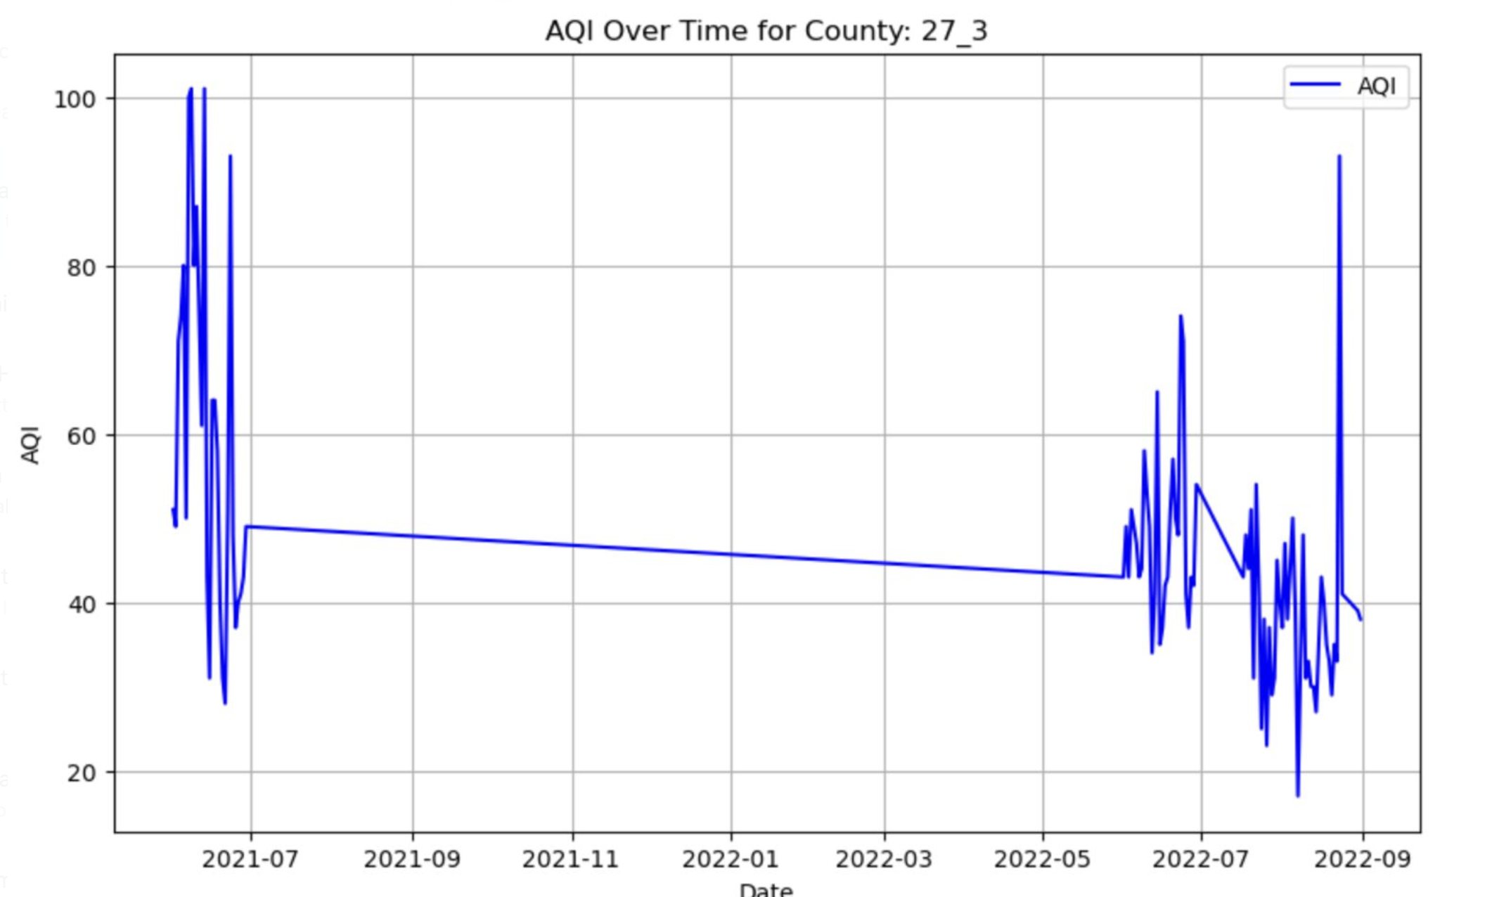
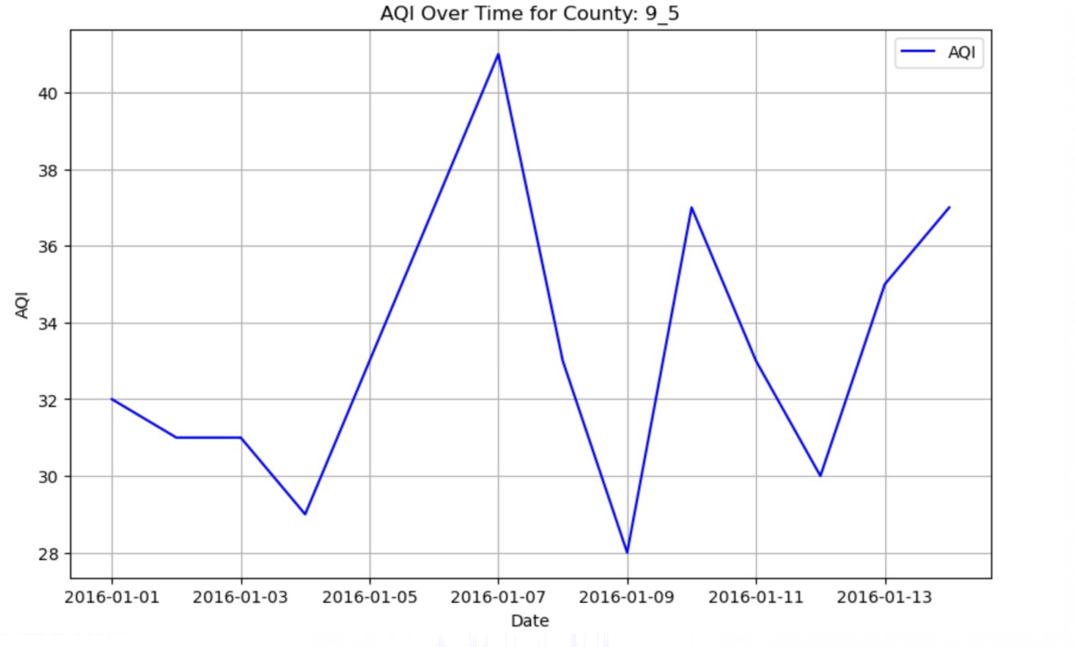
Irregular AQI Distribution in Counties

Slide 12
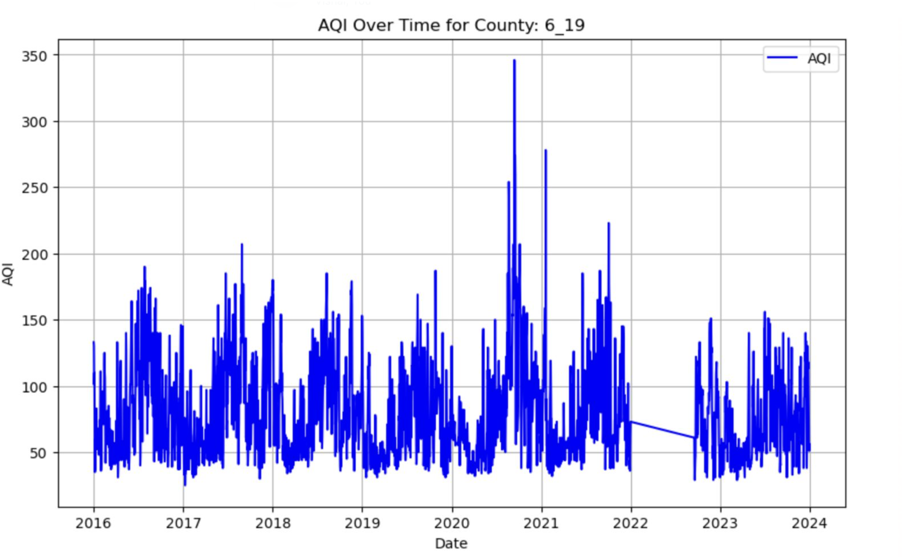
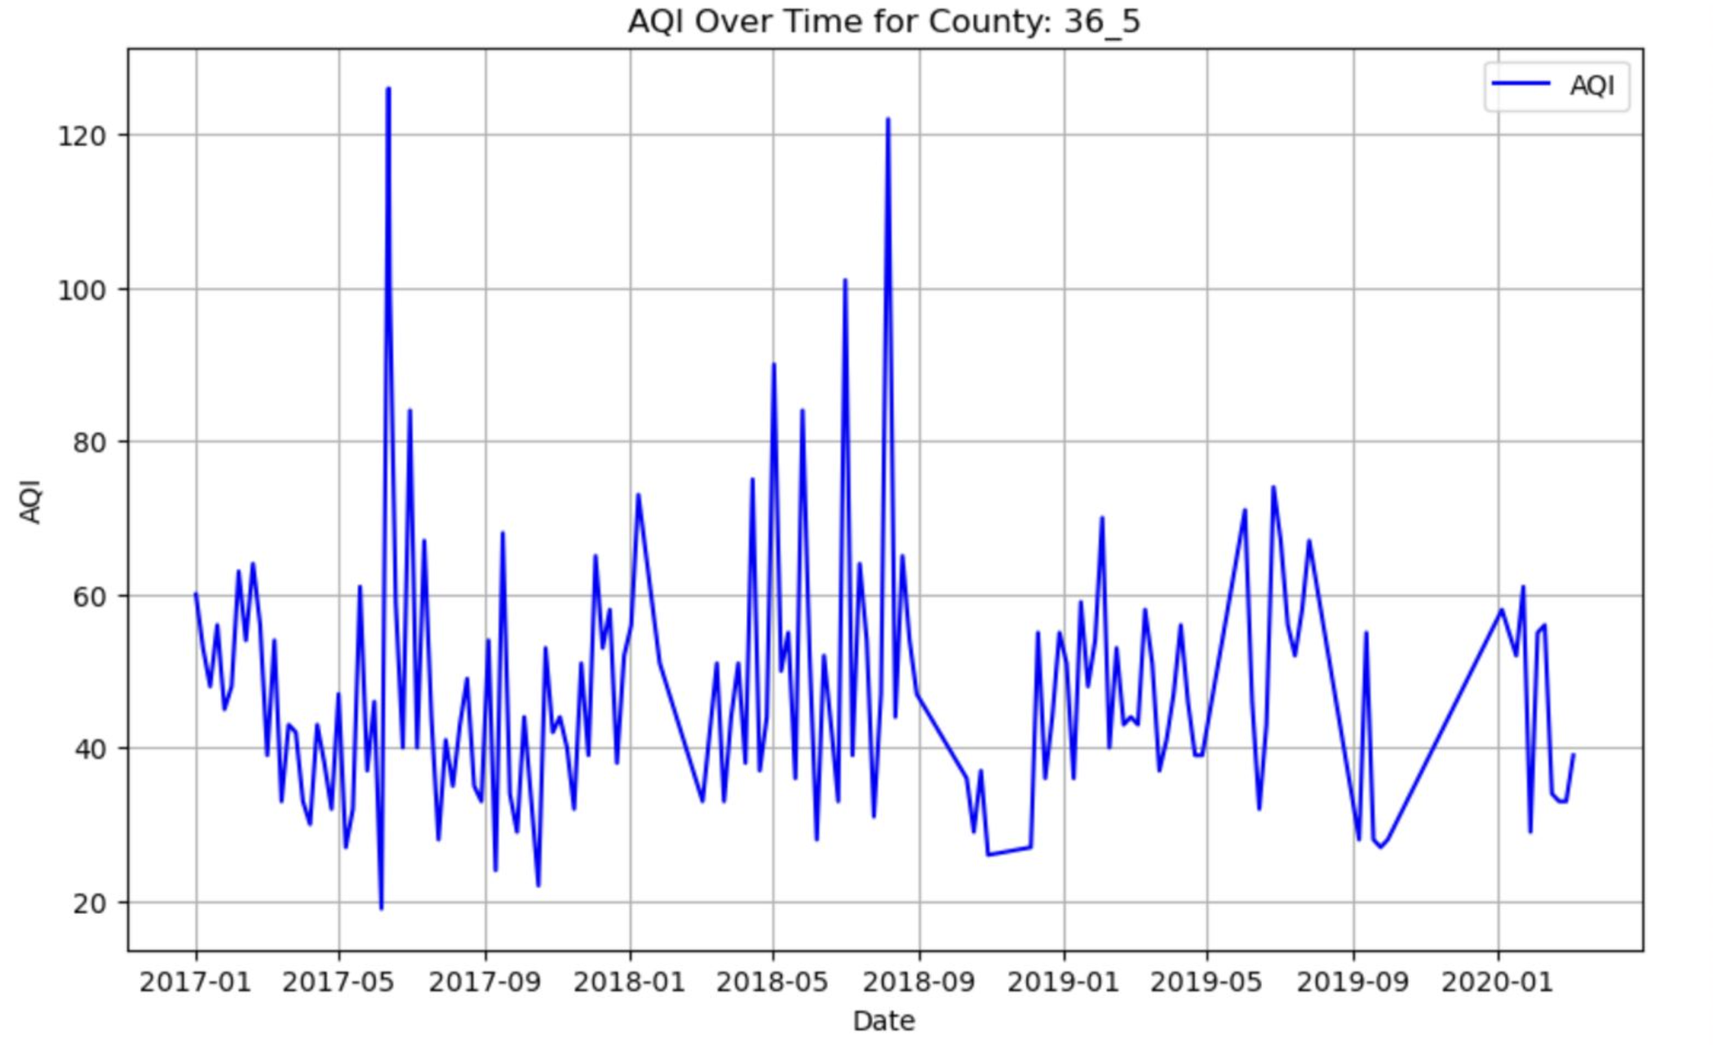
Uniform AQI Distribution Across Counties

Slide 13
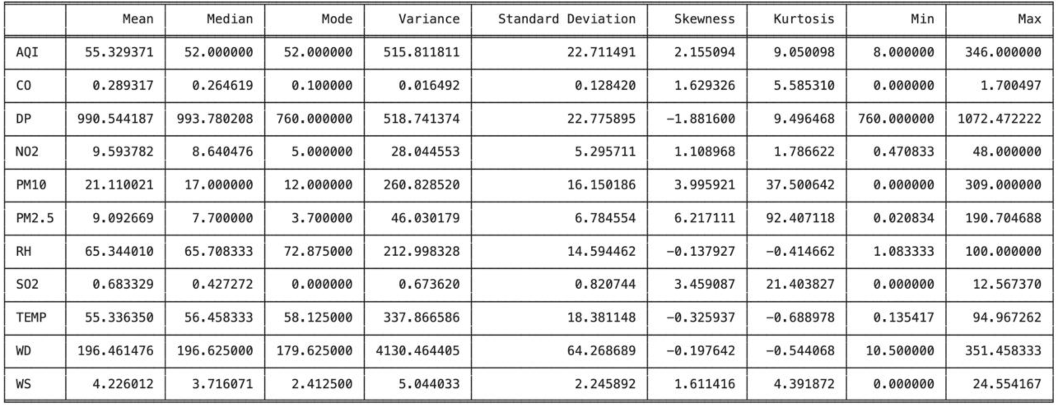
Descriptive Statistics After Data Cleaning

Slide 14
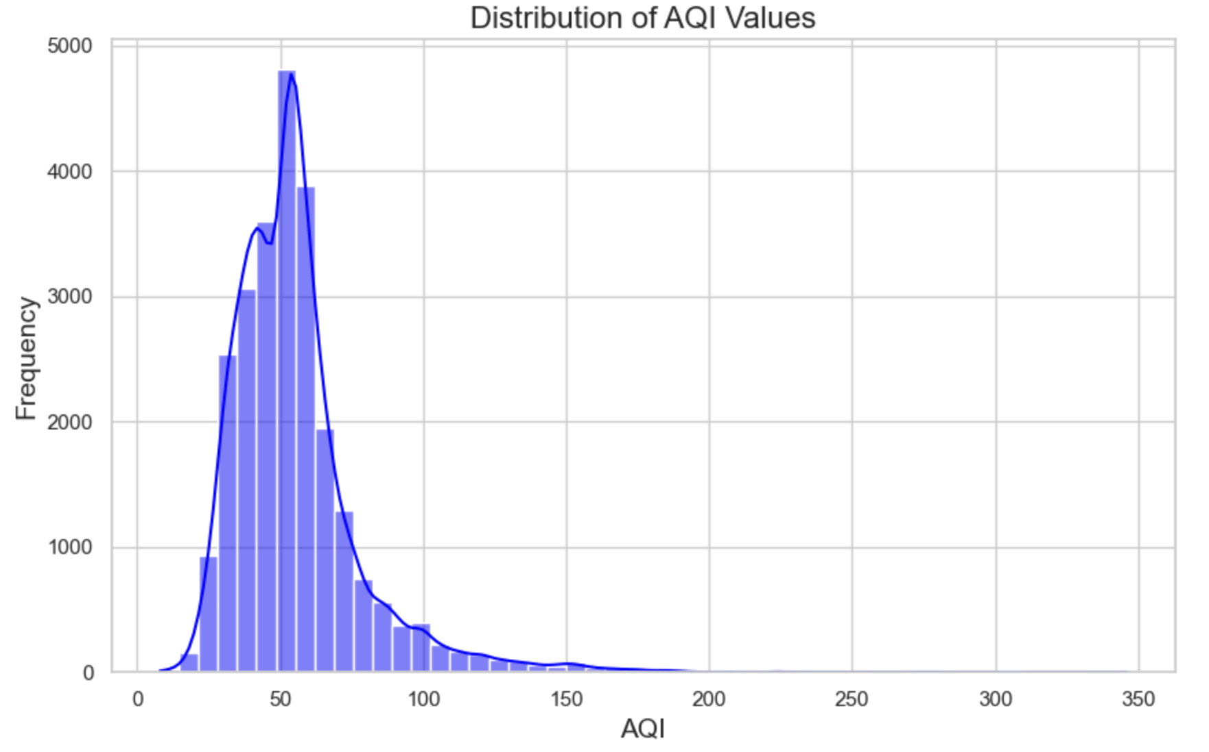
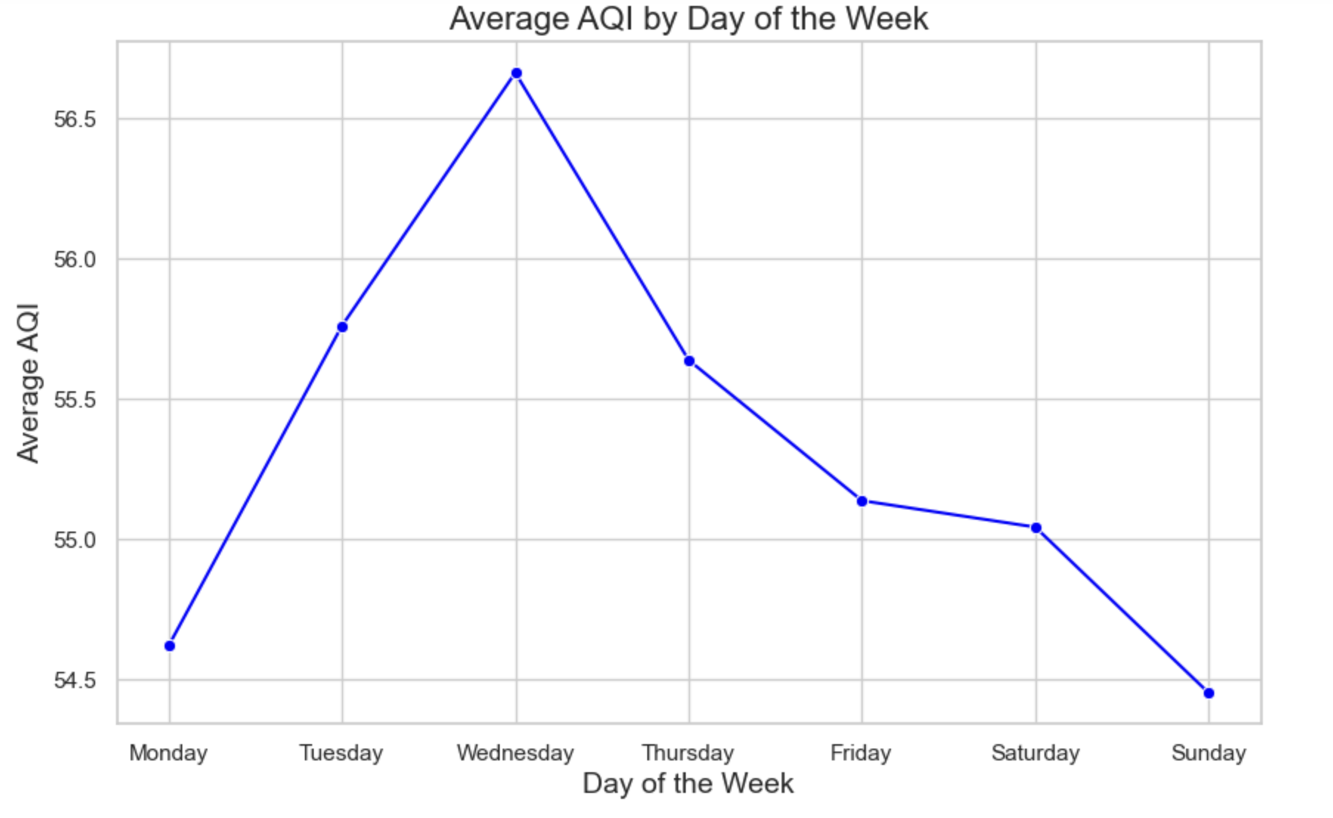
Exploratory Data Analysis

Slide 15
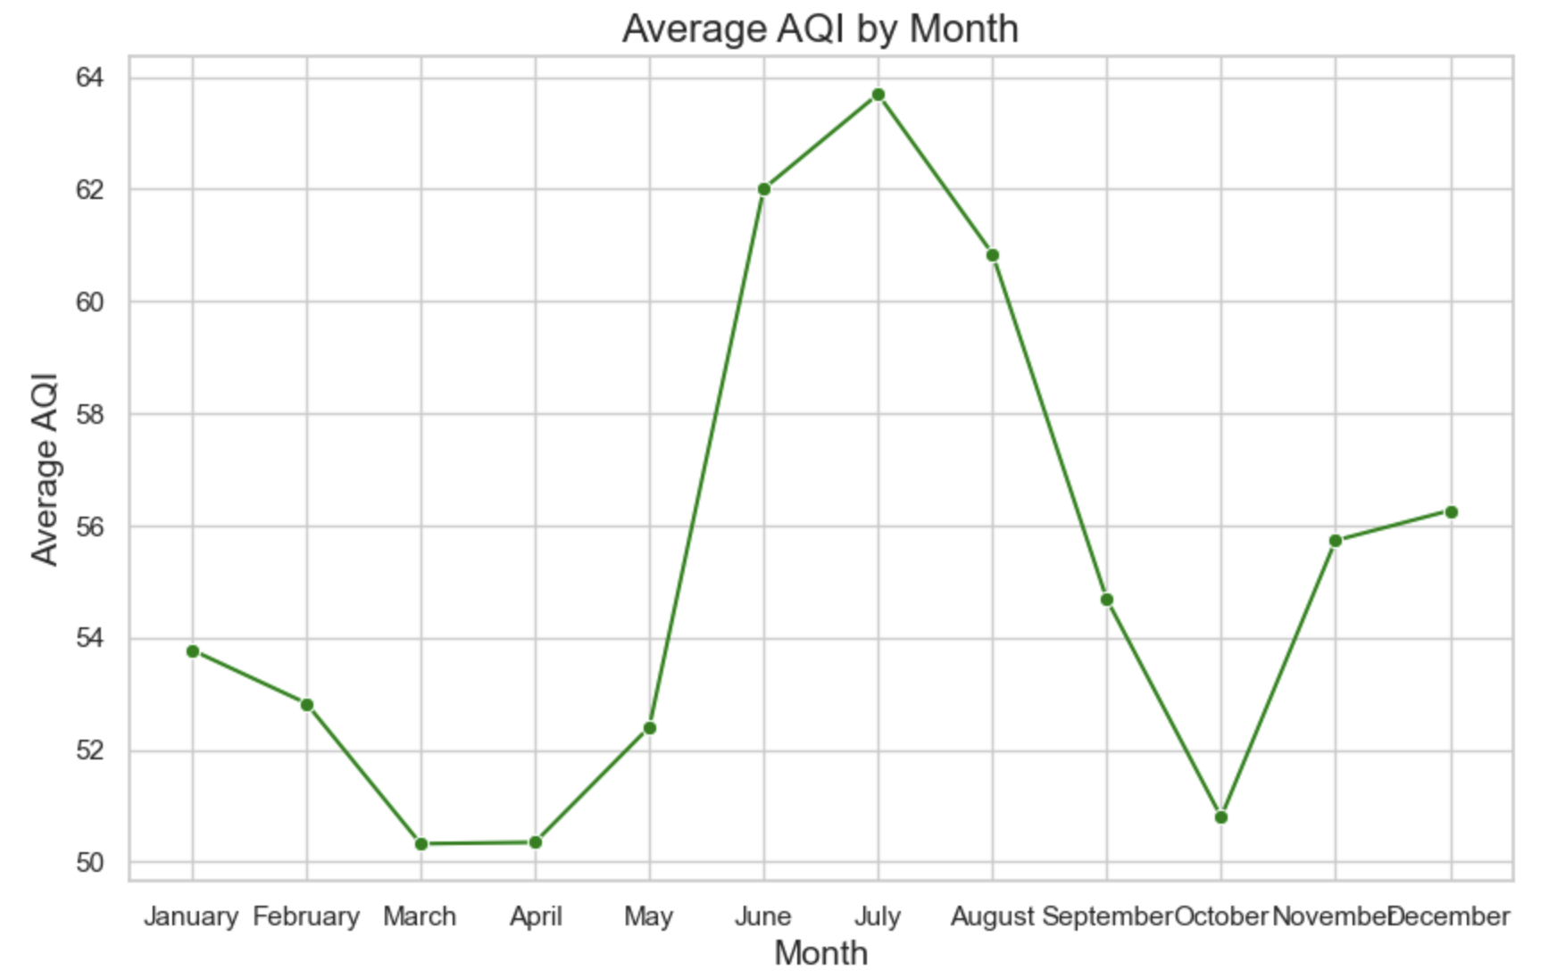
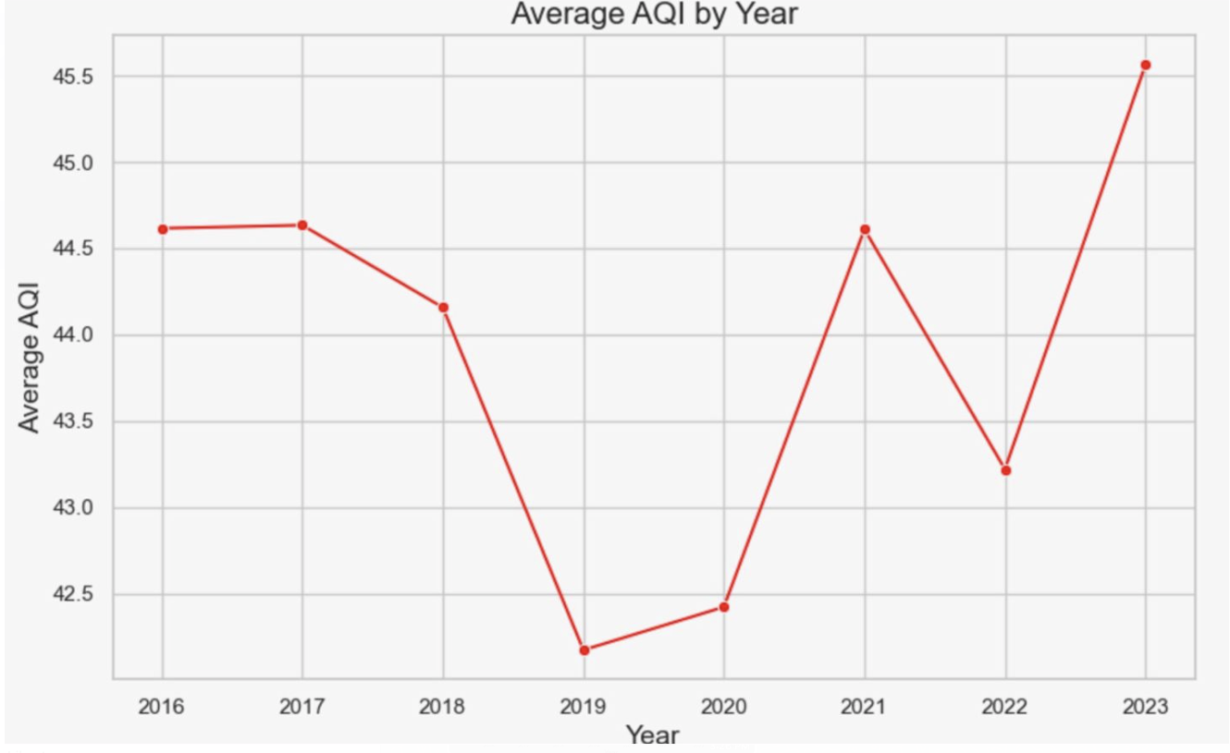
Exploratory Data Analysis Contd..

Slide 16
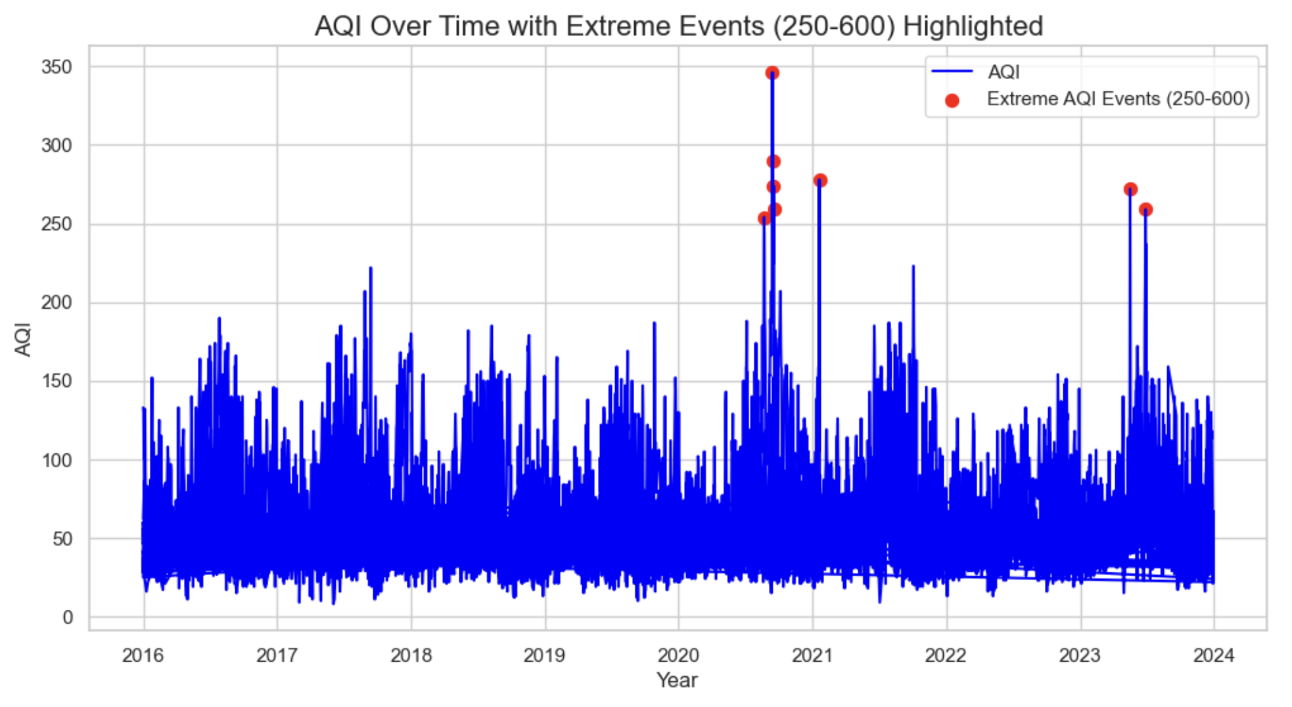

Slide 17
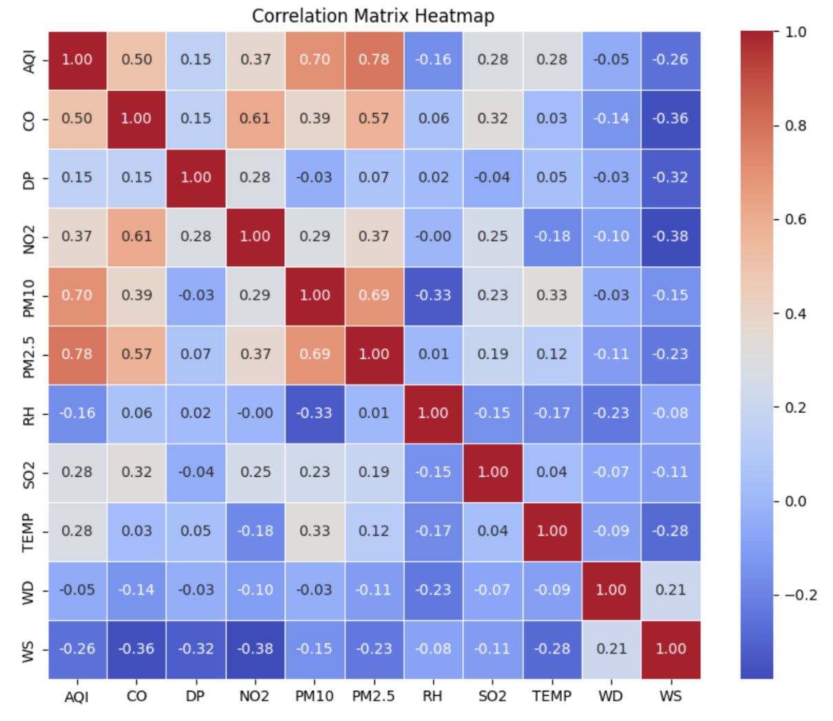

Slide 18
Modelling
Supervised Learning Approach:
Since we have a labeled data and known target variable .
Task: Use Regression Models
CatBoost
Random Forest
Gradient Boosting

Slide 19
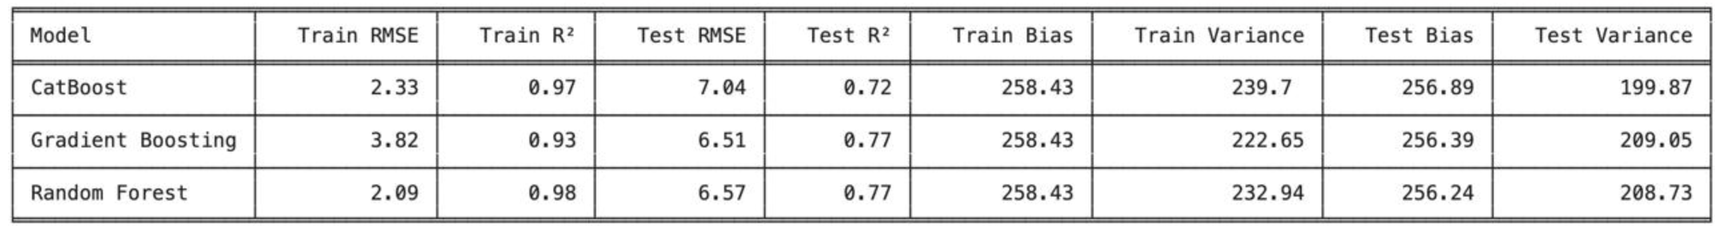
Performance Comparison of Models Before Feature Engineering

Slide 20
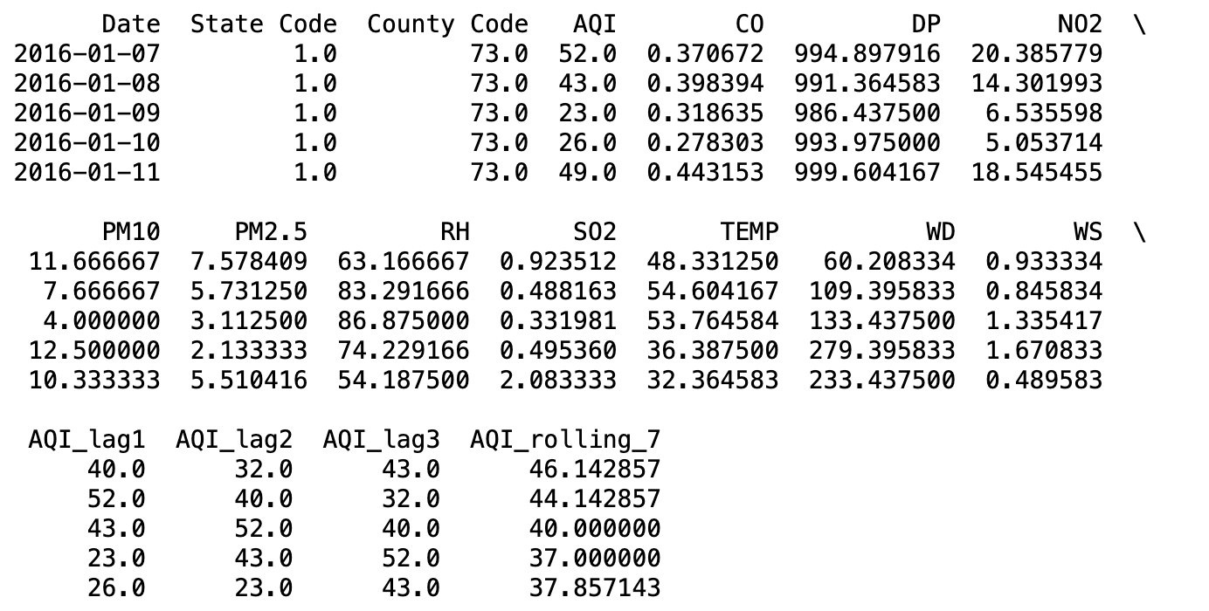
Final Snapshot of Dataset After Adding Lagged and Rolling features

Slide 21
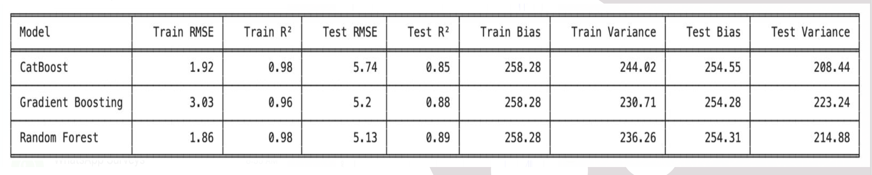
Performance Comparison of Models After Feature Engineering

Slide 22

Chosen Model: Random Forest Model
Obtained High Test R2 (0.89) compared to Other models.
Higher stability and lower overfitting compared to CatBoost and Gradient Boosting.
Better trade-off between bias and variance on test and train sets

Slide 23
REFERENCES
Méndez, M., Merayo, M.G. & Núñez, M. (2023). Machine learning algorithms to forecast air quality: a survey. Artificial Intelligence Rev 56, 10031–1006. https://www.researchgate.net/publication/368571808_Machine_learning_algorithms _to_forecast_air_quality_a_survey
Zayed, R., Abbod, M. F. (2024). Air Quality Index Prediction Using DNN-Markov Modeling. Applied Artificial Intelligence 38(1). https://www.researchgate.net/publication/381780093_Air_Quality_Index_Prediction_Using_DNN- Markov_Modeling
Zhang, Z., Zhang, S., Chen, C. & Yuan, J. (2024). A Systematic Survey of Air Quality Prediction Based on Deep Learning. Alexandria Engineering Journal, Vol 93, Pages 128-141. https://www.sciencedirect.com/science/article/pii/S1110016824002485?ref=pdf_download&fr=RR2&rr=8 cb6472b7966db4f
Zhu, D., Cai, C., Yang, T., & Zhou, X. (2017). A Machine Learning Approach for Air Quality Prediction: Model Regularization and Optimization. Big Data and Cognitive Computing. https://www.researchgate.net/publication/345693711_A_Machine_Learning_Approach_for_Air_Quality_Pr ediction_Model_Regularization_and_Optimization

Slide 24

Thank You

